Slide 1
CECS 326
Operating Systems
CPU Scheduling
(Chapter 6, Operating system Concepts by Silberschatz, Galvin and Gagne)

Slide 2
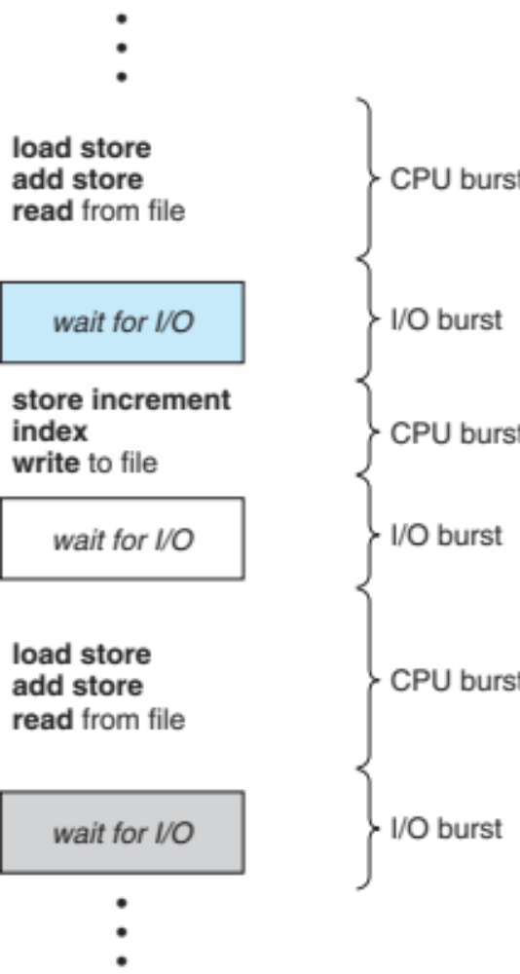
Basic Concepts
CPU-I/O burst cycle – process execution consists of a cycle of CPU execution and I/O wait
CPU burst followed by I/O burst
May increase CPU utilization with multiprogramming
Notes:
CPU burst ↓ Request disk read ↓ I/O burst (waiting) ↓ CPU burst (process the data) ↓ Request disk write ↓ I/O burst ↓ CPU burst ↓
Why is this important for the OS?
Suppose there is only one process.
Process A
CPU -----> wait for disk -----------> CPU
(CPU is idle)
While Process A waits for the disk, the CPU sits idle.
With multiprogramming:
Time →
Process A : CPU ---- wait I/O -------- CPU ----
Process B : CPU ------- CPU ------------
Process C : CPU ------
When Process A enters an I/O burst, the operating system immediately schedules Process B or C. The CPU stays busy, which is why the slide says:
"May increase CPU utilization with multiprogramming."

Slide 3
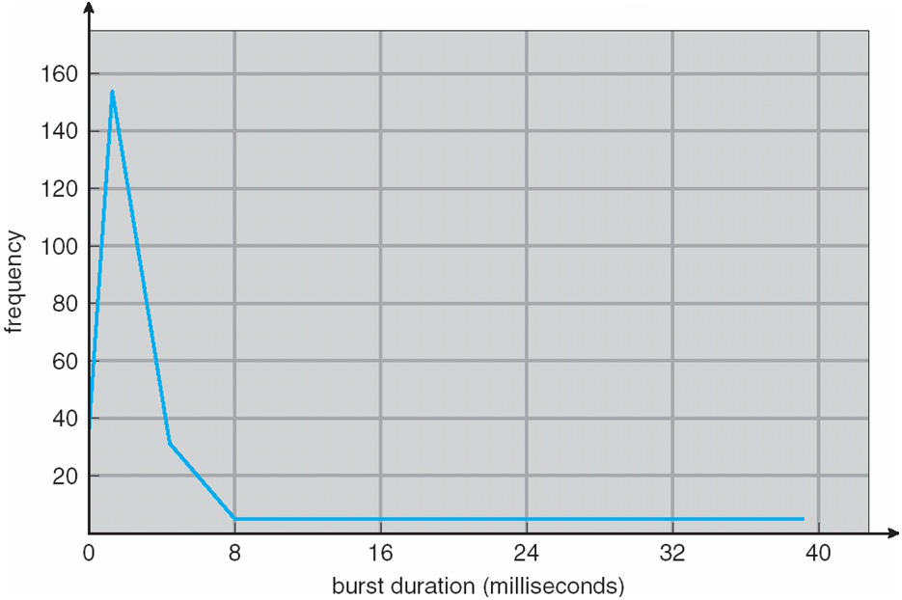
Histogram of CPU-burst Times
Generally characterized as an exponential or hyperexponential distribution, with a large number of short CPU bursts and a small number of long CPU bursts.
I/O-bound programs typically have many short CPU bursts, while CPU-bound programs might have a few long CPU bursts.
Notes:
Brust: khoảng thời gian hoạt động liên tục
Exponential distribution: nhiều CPU brust ngắn, CPU brust dài thì ít
Vd: 1ms, 2ms, 3ms
Hyperexponential distribution: nhiều nhóm process khác nhau
I/O Bound Program: thường để chờ I/O như đọc file, ghi file, …
chỉ dung CPU short brust rồi lại request I/O
CPU bound: many long CPU brust

Slide 4
CPU Scheduler
When the CPU becomes idle, the short-term scheduler selects one of the processes from the ready queue to be executed
Queue may be ordered in various ways
CPU scheduling decisions may take place when a process:
  Switches from running to waiting state
  Switches from running to ready state
  Switches from waiting to ready
  Terminates
Scheduling under 1 and 4 is nonpreemptive
Scheduling under 2 and 3 is preemptive
  Need to be aware of race conditions when data are shared among processes
Notes:
Short-term scheduler: người chọn process tiếp theo trong ready queue để cho CPU execute
Switch to ready state thì Preemptive vì bị CPU giành lấy (ready state là lúc process đợi CPU time)

Slide 5
Dispatcher
The dispatcher module gives control of the CPU to the process selected by the short-term scheduler, this involves:
  Switching context
  Switching to user mode
  Jumping to the proper location in the user program to restart program
Dispatch latency – time it takes for the dispatcher to stop one process and start another running, which should be as fast as possible since it is invoked in every process switch
Notes:
Short term scheduler: chọn process nào chạy tiếp theo trong Ready Queue
Long term scheduler: chọn process nào dc đưa vào hệ thống hay Ready Queue
Dispatcher: giao CPU cho process đó
Dispatcher latency: small as possible để chuyển process này qua process khác nhanh, để CPU sớm chạy tiếp

Slide 6
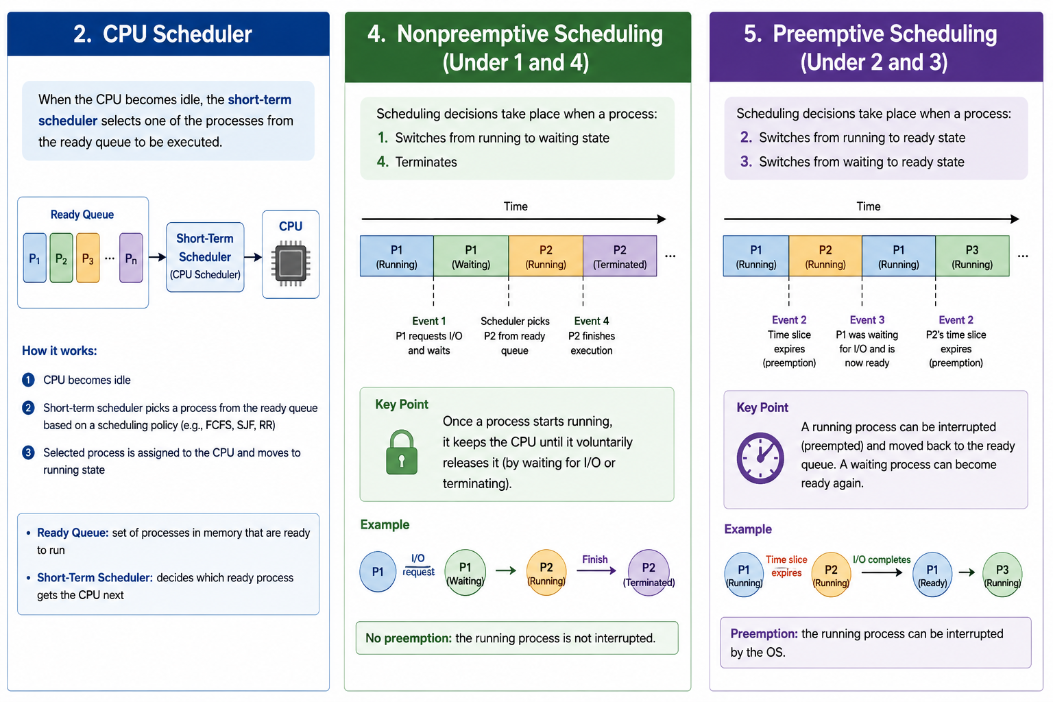

Slide 7
Performance Measures of Scheduling Algorithms
CPU utilization – keep the CPU as busy as possible (Maximize)
Throughput – # of processes that complete their execution per time unit (Maximize)
Turnaround time – amount of time to execute a particular process (Minimize)
Waiting time – amount of time a process has been waiting in the ready queue (Minimize)
Response time – amount of time it takes from when a request was submitted until the first response is produced, not output (for time-sharing environment) (Minimize)
Notes:
Turnaround time: amount of time to execute a process.
tổng thời gian từ lúc process đến hệ thống cho đến khi hoàn thành
Vd: Process được submit lúc 1:00
Process hoàn thành lúc 1:10
Turnaround time = 10 phút
• Waiting time. The CPU-scheduling algorithm does not affect the amount
of time during which a process executes or does I/O. It affects only the
amount of time that a process spends waiting in the ready queue. Waiting
time is the sum of the periods spent waiting in the ready queue.
.
Response time là thời gian từ lúc tiến trình đến hệ thống đến lúc nó được CPU chạy lần đầu tiên.

Slide 8
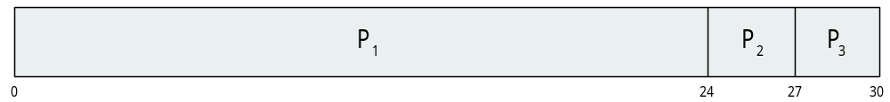
First-Come, First-Served (FCFS) Scheduling
Given Process Burst Time
P₁ 24
P₂ 3
P₃ 3
Suppose three processes arrive in the order P₁ , P₂ , P₃
Gantt chart for the FCFS schedule is:
Waiting time for P₁ = 0; P₂ = 24; P₃ = 27
Average waiting time: (0 + 24 + 27)/3 = 17
Notes:
Waiting time P1 là 0 vì P1 đến đầu tiên nên CPU chạy trước
P2 chờ Brust time(hoạt động liên tục) nên của P1

Slide 9

FCFS Scheduling (cont.)
Suppose the three processes arrive in the order P₂ , P₃ , P₁
Then Gantt chart for the schedule is
Waiting time for P₁ = 6; P₂ = 0; P₃ = 3
Average waiting time: (6 + 0 + 3)/3 = 3
Much better than previous case
Convoy effect - short process behind long process
  E.g., consider one CPU-bound and many I/O-bound processes
Notes:
Convoy effect xảy ra khi một process có CPU burst rất dài chạy trước, khiến nhiều process ngắn phía sau phải chờ.
Vd: P1 = 24 ms
P2 = 3 ms
P3 = 3 ms

Slide 10
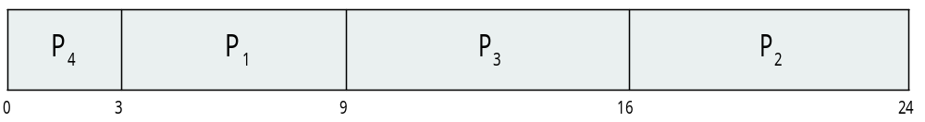
Shortest-Job-First (SJF) Scheduling
Associate with each process the length of its next CPU burst, and use these lengths to schedule the process with the shortest time
SJF schedule is optimal – it gives the minimum waiting time for a given set of processes
  Difficulty is knowing the length of the next CPU request
Example: ProcessArriva l Burst Time
P₁ 0.0 6
P₂ 2.0 8
P₃ 4.0 7
P₄ 5.0 3
SJF scheduling chart
Average waiting time = (3 + 16 + 9 + 0) / 4 = 7
Notes:
SJF: It selects the shortest next CPU burst
Tất cả arrival = 0 nên
P4 đến mà ko cần wait => =0
P1 đến đợi P4 xong => =3
P3 đến đợi P4 & P1 xong => =6+3
P2 đến đợi P4 & P1 & P3 xong => 6+3+7
Mỗi process chỉ chờ từ thời điểm t=0

Slide 11
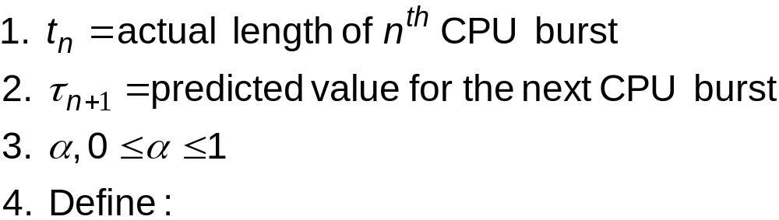
Determining Length of Next CPU Burst
Can only estimate – should be similar to the previous one – then pick process with shortest predicted next CPU burst
Can be done by using the length of previous CPU bursts using exponential averaging
Commonly, α set to ½
The preemptive version is called shortest-remaining-time-first
Notes:
The preemptive version is called shortest-remaining-time-first
nếu process mới đến có brust time ngắn hơn thì CPU lấy process đó
SJF: process đã chạy thì thường chạy đến khi hoàn thành CPU burst.

Slide 12
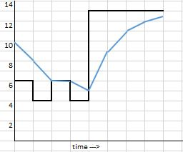
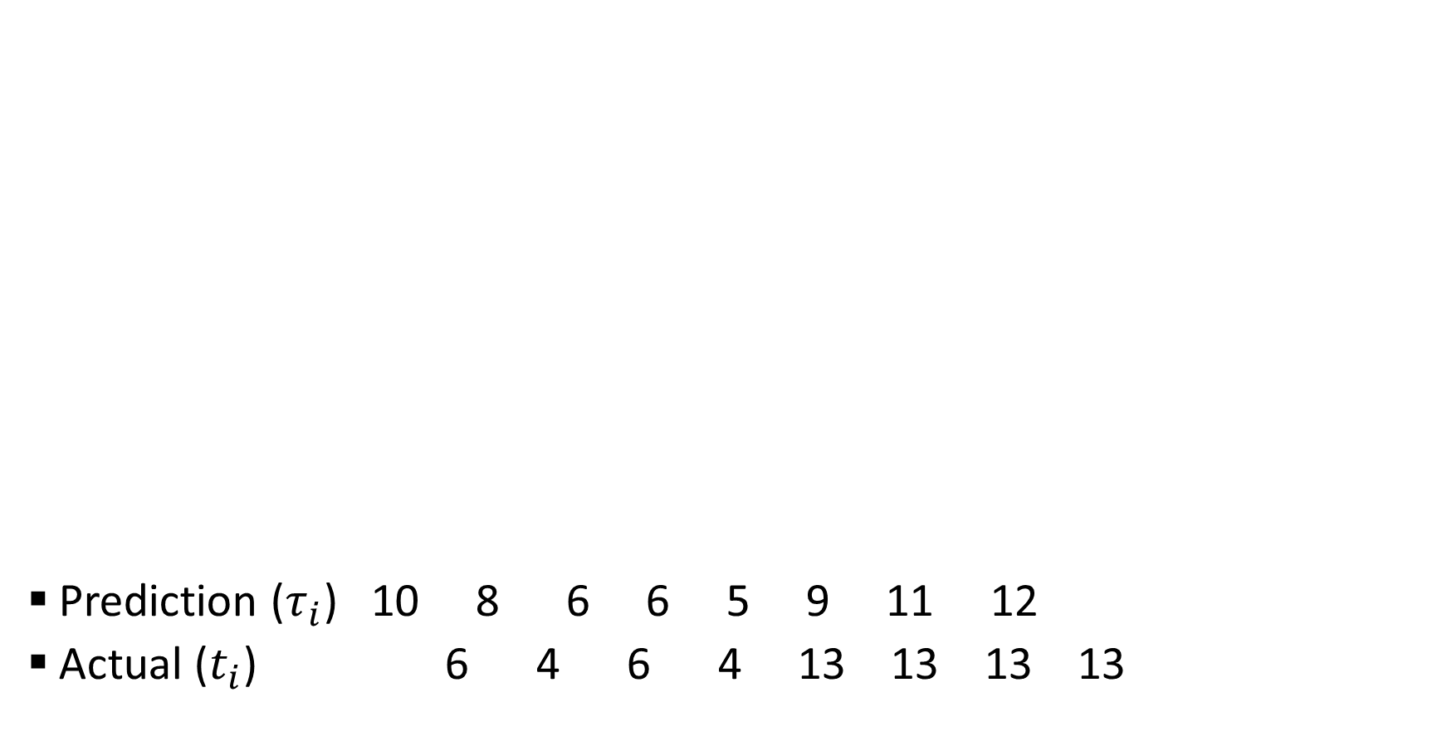
Prediction of the Length of the Next CPU Burst
Prediction ($τ_{i}$) 10 8 6 6 5 9 11 12
Actual ($t_{i}$) 6 4 6 4 13 13 13 13
Notes:
Tou_0 = 10

Slide 13
Examples of Exponential Averaging
α =0
  τ_{n+1} = τ_{n}
  Recent history does not count
α =1
  τ_{n+1} = α t_{n} = t_{n}
  Only the actual last CPU burst counts
If we expand the formula, we get:
    τ_{n+1} = α t_{n}+(1 - α)α t_{n} ₋₁ + …
    +(1 - α )^{j} α t_{n} _{-j} + …
    +(1 - α )^{n +1} τ₀
  Since both α and (1 - α) are less than or equal to 1, each successive term has less weight than its predecessor

Slide 14

Example of Shortest-Remaining-Time-First Scheduling
Add the concepts of varying arrival times and preemption to the analysis
ProcessA Arrival TimeT Burst Time
P₁ 0 8
P₂ 1 4
P₃ 2 9
P₄ 3 5
Preemptive SJF Gantt Chart
Average waiting time = [(10-1)+(1-1)+(17-2)+5-3)]/4 = 26/4 = 6.5
Notes:
Phiên bản preemptive của SJF:
-t=0:
P1 đến trước nên vào
t = 1:
P1 còn 8-1=7, P2 = 4 (P1 đã chạy 1 unit)
→ chọn P2
t = 2:
P1 còn 7, P2 còn 4-1=3, P3 = 9 (P2 đã chạy 1 unit)
→ vẫn chọn P2
t = 3:
P1 còn 7, P2 còn 3-1=2, P3 = 9, P4 = 5 (P2 đã chạy 1 unit)
→ vẫn chọn P2
Từ t=3 này trở đi ko có process mới nào đến nên nó chạy cho đến khi hoàn thành là t=5
t = 5:
P4 = 5, P3=9, P1=7
Chọn P4 và P4 chạy đến t=10 (vì P4 còn 5 burst time) và P4 hoàn thành
t = 10:
P1=7, P3=9
Chọn P1 và P1 chạy đến t=17 và P1 hoàn thành
- t = 17:
Cuối cùng là P3 chạy đến t=26 và P3 hoàn thành
==============
Cách tính waiting time:
Waiting time = Completion time − Arrival time − Burst time
Completion time là số ở phía bên phải ô

Slide 15
Priority Scheduling
A priority number (integer) is associated with each process
The CPU is allocated to the process with the highest priority (convention: smallest integer ≡ highest priority). Scheduling may be preemptive or nonpreemptive.
SJF is priority scheduling where priority is based on the predicted next CPU burst time
  Problem: starvation (low priority processes may have to wait a long time to get executed
  Solution: aging (priority of process increases as time progresses)
Notes:
Highest priority = smallest integer
Priority scheduling: chọn process có priority cao nhất.
SJF: xem CPU burst ngắn hơn là priority cao hơn.
Major problem: starvation => process có priority thấp thì phải chờ rất lâu và có thể ko bh dc chạy
Aging: kĩ thuật tăng priority của process khi nó chờ quá lâu

Slide 16
Example of Priority Scheduling (Nonpreemptive)
Given the following processes in the system
ProcessA Burst TimeT Priority
P₁ 1 1
P₂ 5 2
P₃ 2 4
P₄ 1 5
P₅ 10 3
Priority scheduling Gantt Chart
Average waiting time = 8.2 msec
P
P
P
P
P
1
2
5
3
4
0
1
6
1
6
1
8
1
9
Notes:
Không có preemptive nên arrival = 0
Waiting time = thời điểm bắt đầu chạy − arrival time

Slide 17
Round Robin (RR) Scheduling
Each process gets a small unit of CPU time (time quantum q), usually 10-100 milliseconds. After this time has elapsed, the process is preempted and added to the end of the ready queue.
If there are n processes in the ready queue and the time quantum is q, then each process gets 1/n of the CPU time in chunks of at most q time units at once. No process waits more than (n-1)q time units.
Timer interrupts every quantum to schedule next process
Performance
  q large ⇒ FIFO
  q small ⇒ q must be large with respect to context switch, otherwise overhead is too high
Notes:
Round Robin is preemptive
Trong Round Robin, mỗi process được cấp một khoảng CPU nhỏ gọi là time quantum.
Nếu process chưa hoàn thành sau quantum, process bị preemptive and move to the end of ready queue
Lấy process tiếp theo ở đầu ready queue.
If there are $n$processes in the ready queue, each process receives approximately:
1/n
=> Nghĩa là mỗi process sẽ nhận time quantum bằng nhau

Slide 18

Example of RR with Time Quantum q = 4
Process Burst Time
P₁ 24
P₂ 3
P₃ 3
The Gantt chart is:
Typically, higher average turnaround than SJF, but better response
q should be large compared to context switch time
E.g., q may be set to 10ms to 100ms,with context switch < 10 μsec
Notes:
Let’s calculate the average waiting time for this schedule. P1 waits for 6 milliseconds
(10 − 4), P2 waits for 4 milliseconds, and P3 waits for 7 milliseconds.
Thus, the average waiting time is 17/3 = 5.66 milliseconds.
Mỗi process sẽ chạy đủ 4 time quantum và preempt cho process tiếp theo
Waiting time = Completion time – arrival time – burst time
Arrival = 0 (đề ko cho)
P1 waiting time = 30 – 0 -24 = 6
P2 = 7 – 0 – 3 = 4
P3 = 10 – 0 – 3 = 7

Slide 19
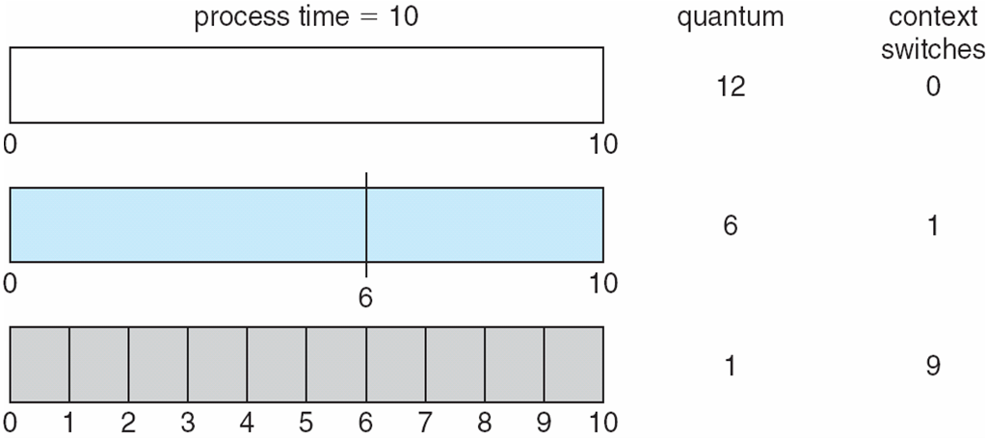
Time Quantum and Context Switch Time
Notes:
A time quantum that is too small wastes CPU time because of: Context-switch overhead
chuyển process nhiều lần thì time trong lúc chuyển sẽ bị coi là lãng phí
Vd: P1 chạy 1 ms
Context switch mất 0.2 ms
P2 chạy 1 ms
Context switch mất 0.2 ms

Slide 20
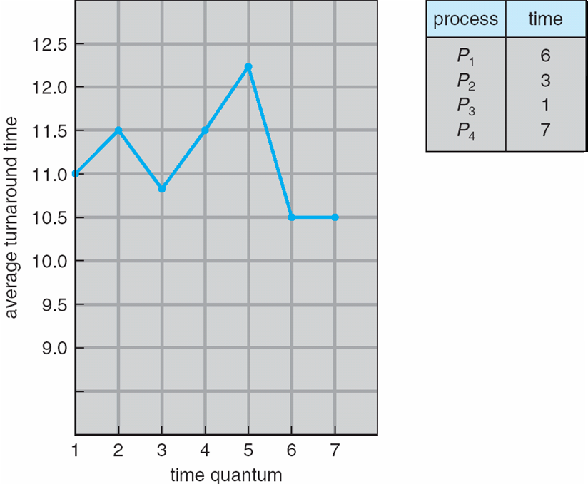
Turnaround Time Varies with Time Quantum
80% of CPU bursts should be shorter than q

Slide 21
Multilevel Queues
Ready queue is partitioned into separate queues, eg:
  foreground (interactive)
  background (batch)
Process permanently in a given queue
Each queue has its own scheduling algorithm:
  foreground – RR
  background – FCFS
Scheduling must be done between the queues:
  Fixed priority scheduling; (i.e., serve all from foreground then from background). Possibility of starvation.
  Time slice – each queue gets a certain amount of CPU time which it can schedule amongst its processes; e.g., 80% to foreground in RR, 20% to background in FCFS
Notes:
Multilevel queue: chia ready queue ra thành nhiều queue cho các loại process
Foreground(interative): browser, notepad, terminal => tương tác trực tiếp với ng dung
Background(batch): sao lưu data, … => ko cần phản hồi ngay
Foreground → interactive → cần phản hồi nhanh → Round Robin
Background → batch → thường dùng FCFS

Slide 22
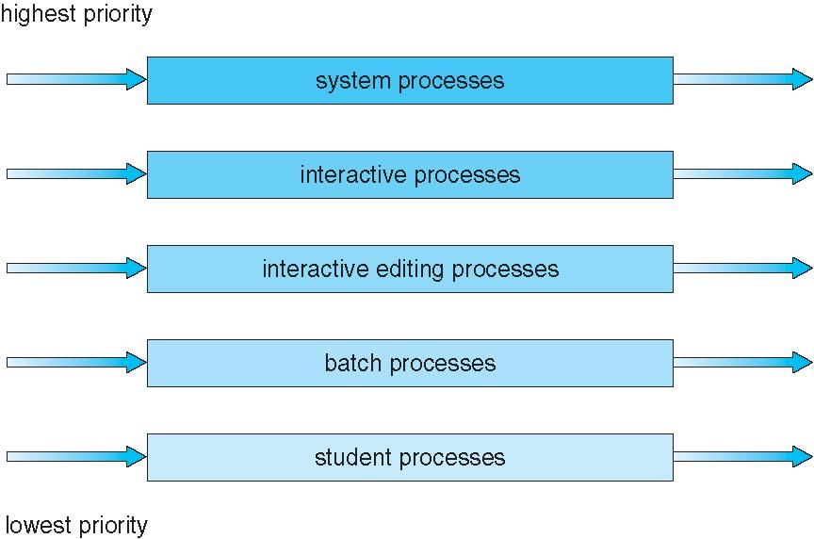
Multilevel Queue Scheduling

Slide 23
Multilevel Feedback Queue
A process can move between the various queues; aging can be implemented this way
Multilevel-feedback-queue scheduler defined by the following parameters:
  number of queues
  scheduling algorithms for each queue
  method used to determine when to upgrade a process
  method used to determine when to demote a process
  method used to determine which queue a process will enter when that process needs service
Notes:
Multilevel queue: Process permanently in a given queue
Multilevel feedback queue: process can move various queue

Slide 24

Example of Multilevel Feedback Queue
Three queues:
  Q₀ – RR with time quantum 8 milliseconds
  Q₁ – RR time quantum 16 milliseconds
  Q₂ – FCFS
Scheduling
  A new job enters queue Q₀ which is served FCFS
    When it gains CPU, job receives 8 milliseconds
    If it does not finish in 8 milliseconds, job is moved to queue Q₁
  At Q₁ job is again served FCFS and receives 16 additional milliseconds
    If it still does not complete, it is preempted and moved to queue Q₂

Slide 25
Thread Scheduling
There is distinction between user-level and kernel-level threads
When threads are supported, scheduling units are threads, not processes
May use many-to-one or many-to-many model. Thread library schedules user-level threads to run on LWP
  Known as process-contention scope (PCS) since scheduling competition is within the process
  Typically done via priority set by programmer
Kernel thread scheduled onto available CPU is system-contention scope (SCS) – competition among all threads in system
Notes:
In Chapter 4, we introduced threads to the process model, distinguishing
between user-level and kernel-level threads. On most modern operating systems
it is kernel-level threads—not processes—that are being scheduled by
the operating system. User-level threads are managed by a thread library, and
the kernel is unaware of them
lightweight process (LWP)
User applications create user-level threads, which must ultimately be
mapped to kernel threads to execute on a CPU. The many-to-one model
maps many user-level threads to one kernel thread. Other approaches
include the one-to-one and many-to-many models.
process-contention scope (PCS)
Trong PCS, các user threads trong cùng một process cạnh tranh với nhau để được thư viện thread chọn chạy trên kernel thread có sẵn.
PCS = user threads trong cùng một process cạnh tranh với nhau
SCS = kernel threads trong toàn hệ thống cạnh tranh với nhau
=> Scheduler sẽ quyết định thread nào chạy dựa trên priority, chính sách scheduling và lượt chờ.

Slide 26
Pthread Scheduling
Most applications that run on modern computers as separate processes, each consisting of multiple threads
Benefits of multithreaded programming include:
  Responsiveness: one thread can attend to user demands while other threads continue to execute
  Resource sharing: threads in a process share memory & other resources
  Economy: no additional resource allocation for creation of new threads
  Scalability, with multiprocessor architecture
Pthread, refers to the POSIX standard, defines APIs for thread creation and synchronization
API allows specifying either PCS or SCS during thread creation
  PTHREAD_SCOPE_PROCESS schedules threads using PCS scheduling
  PTHREAD_SCOPE_SYSTEM schedules threads using SCS scheduling
Can be limited by OS – Linux and Mac OS X only allow PTHREAD_SCOPE_SYSTEM
Notes:
Tạo thread tiết kiệm hơn tạo process mới vì các thread trong cùng process dùng chung nhiều tài nguyên

Slide 27
Multiple-Processor Scheduling
CPU scheduling becomes more complex when multiple CPUs are available
Multiprocessor architecture: homogeneous processors or heterogeneous processors within a multiprocessor
Approaches to multiple-processor scheduling
  Asymmetric multiprocessing – only one processor accesses the system data structures, alleviating the need for data sharing
  Symmetric multiprocessing (SMP) – each processor is self-scheduling, all processes in common ready queue, or each has its own private queue of ready processes
    Currently, most common
Processor affinity – process has affinity for processor on which it is currently running
  soft affinity – attempt to keep on the same processor, but not guaranteed
  hard affinity
  Variations including processor sets
Notes:
Homogeneous processors are processors that: Have similar capabilities
khả năng xử lí tương đương
Heterogeneous processors:
Core mạnh → xử lý tác vụ nặng
Core tiết kiệm điện → xử lý tác vụ nhẹ
In asymmetric multiprocessing:
One processor handles system data structures and scheduling decisions
In symmetric multiprocessing: Each processor can schedule itself
Processor affinity nghĩa là process có xu hướng tiếp tục chạy trên CPU mà nó vừa chạy trước đó.
Soft affinity nghĩa là hệ điều hành cố gắng cho process tiếp tục chạy trên CPU cũ, nhưng vẫn có thể chuyển nó sang CPU khác khi cần.

Slide 28
Multiple-Processor Scheduling – Load Balancing
If SMP, need to keep all CPUs loaded for efficiency
Load balancing attempts to keep workload evenly distributed. Needed when each processor has its own private queue of ready processes
  Push migration – a task periodically checks load on each processor, and, if found imbalance, pushes task from overloaded CPU to other CPUs
  Pull migration – idle processors pulls waiting task from busy processor
Notes:
SMP: Symmetric Multi Processing
Load balancing là phân phối công việc tương đối đều giữa các CPU/core.
CPU 1: P1, P2, P3, P4
CPU 2: không có process

Slide 29
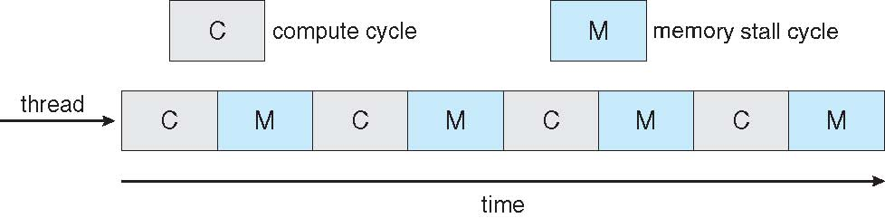

Multicore Processors
Recent trend to place multiple processor cores on same physical chip
Benefits: faster and consumes less power
The practice of multiple threads per core is also growing (e.g., hyperthreading on Intel)
  Takes advantage of memory stall to make progress on another thread while memory retrieve happens

